Slide 1
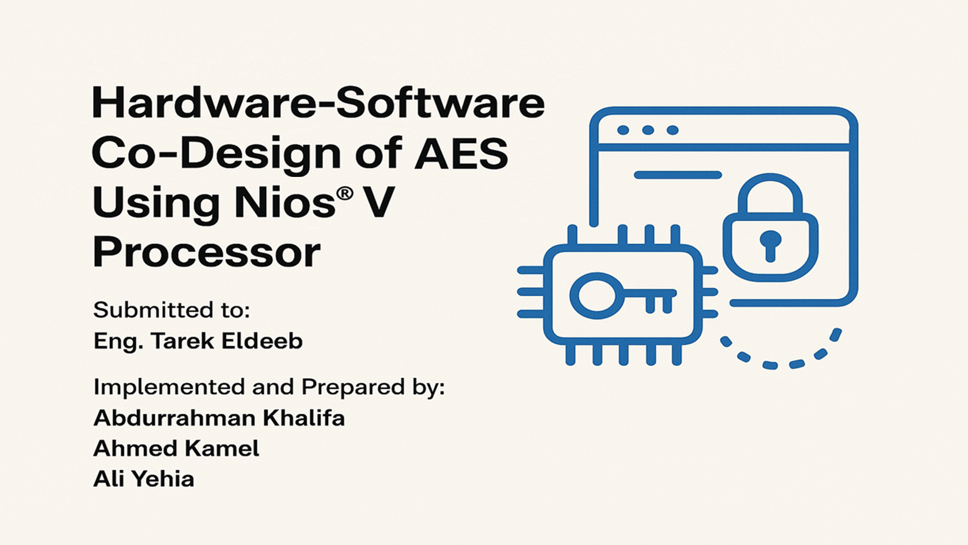

Slide 2
Contents
Advanced Encryption Standard Overview
Practical Usages of AES at the Chip Level
System Configuration in Quartus
Outputs Overview
Live Demonstration
1

Slide 3
Practical Usages of AES at the Chip Level
Secure Boot and Firmware Authentication:
AES is used to encrypt and authenticate firmware images.
Secure Communication (e.g., I2C, SPI, AXI Interfaces):
AES is added to communication paths between processors and peripherals.
DRM (Digital Rights Management):
Used in media devices like smart TVs and set-top boxes to decrypt protected content.
Trusted Execution Environments (TEEs):
Embedded AES inside secure enclaves (e.g., ARM TrustZone) for handling sensitive data.
2

Slide 4
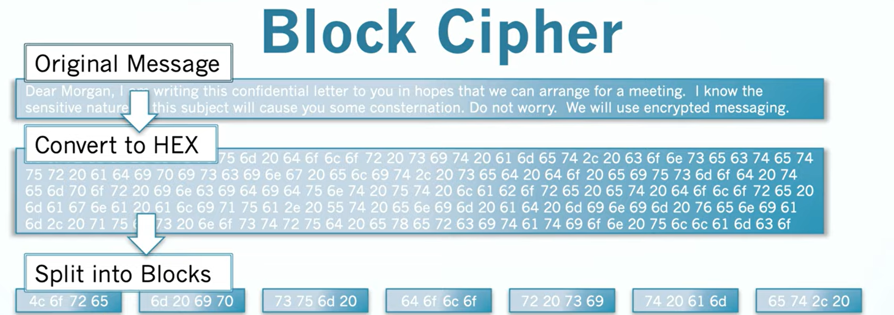
Advanced Encryption Standard (AES) Overview
3

Slide 5
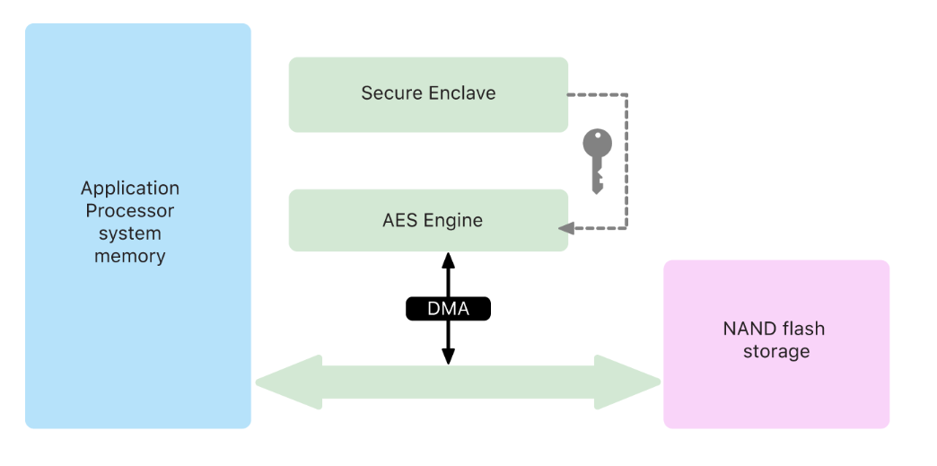
Apple’s Secure Enclave (used in iPhones and Macs):
AES-256 is used for:
Encrypting biometric data (Touch ID / Face ID).
Encrypting files on-disk (Data Protection).
Secure key management.
Used in A8-18, S3-9 and M1-4
Apple Platform Security – Secure Enclave and AES
4

Slide 6
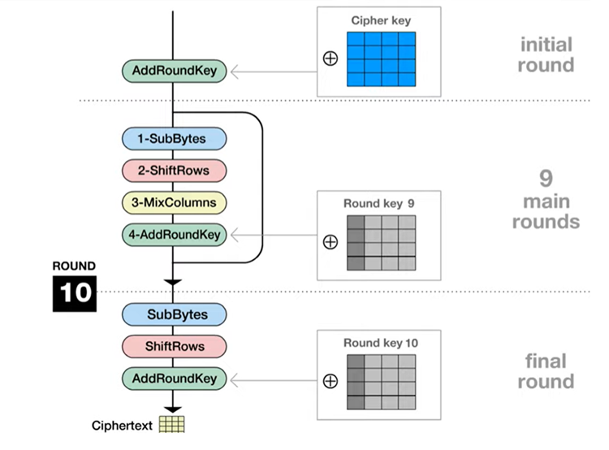
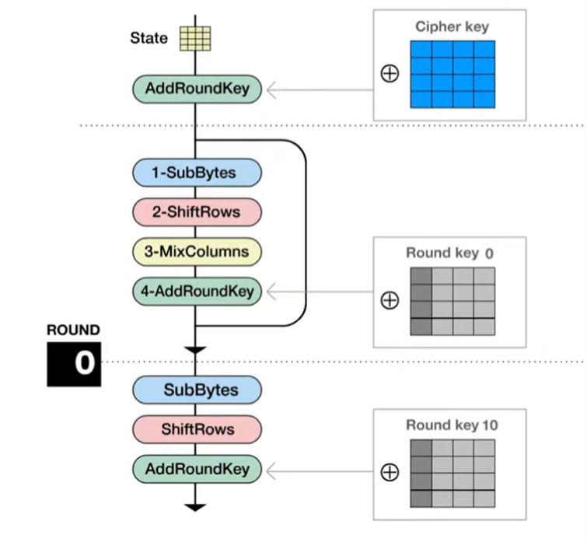
Advanced Encryption Standard (AES) Overview
5

Slide 7
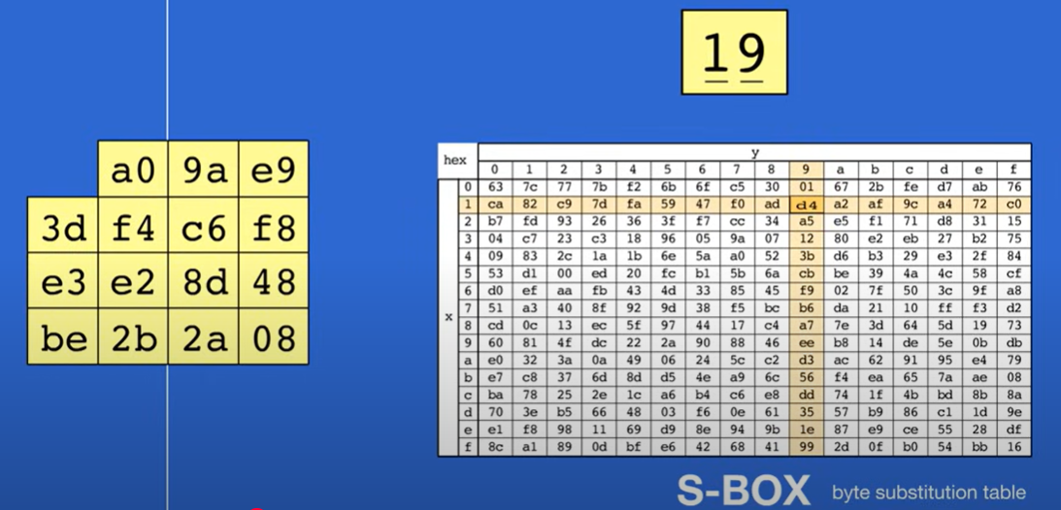
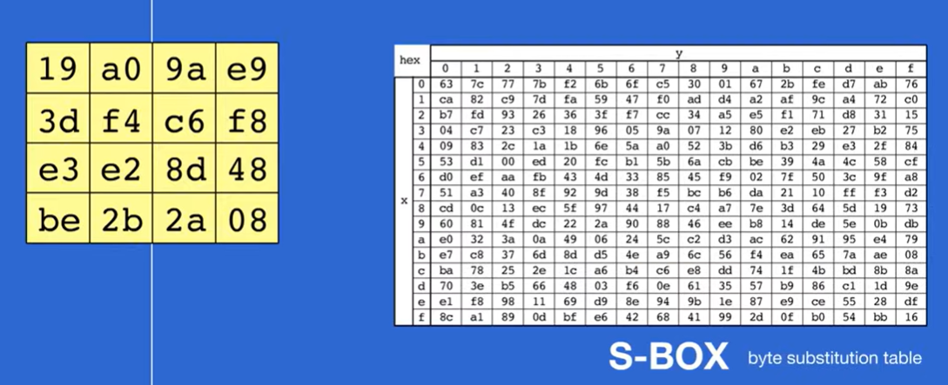
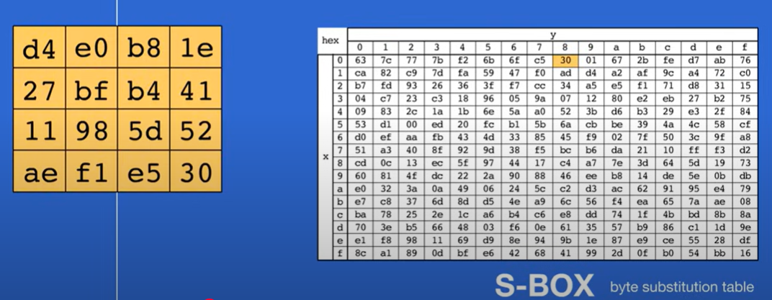
Advanced Encryption Standard (AES) Overview
1- SubBytes
6

Slide 8
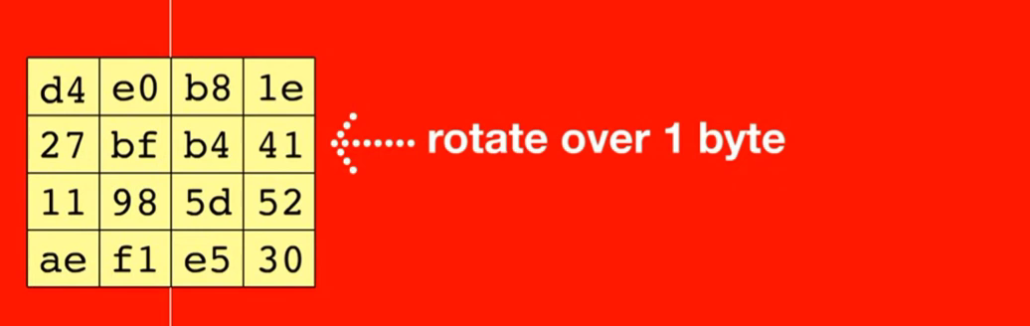
Advanced Encryption Standard (AES) Overview
2- ShiftRows
7

Slide 9
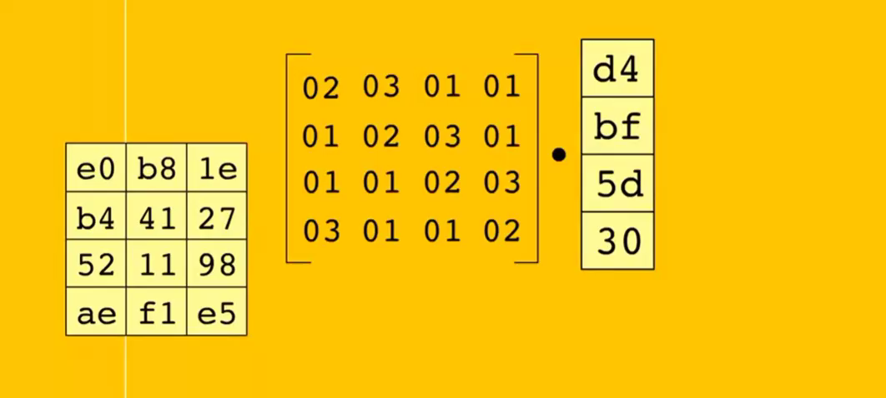
Advanced Encryption Standard (AES) Overview
3- MixColumns
8

Slide 10
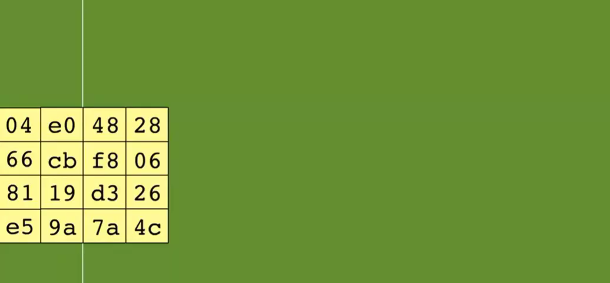
Advanced Encryption Standard (AES) Overview
4- AddRoundKey
9

Slide 11
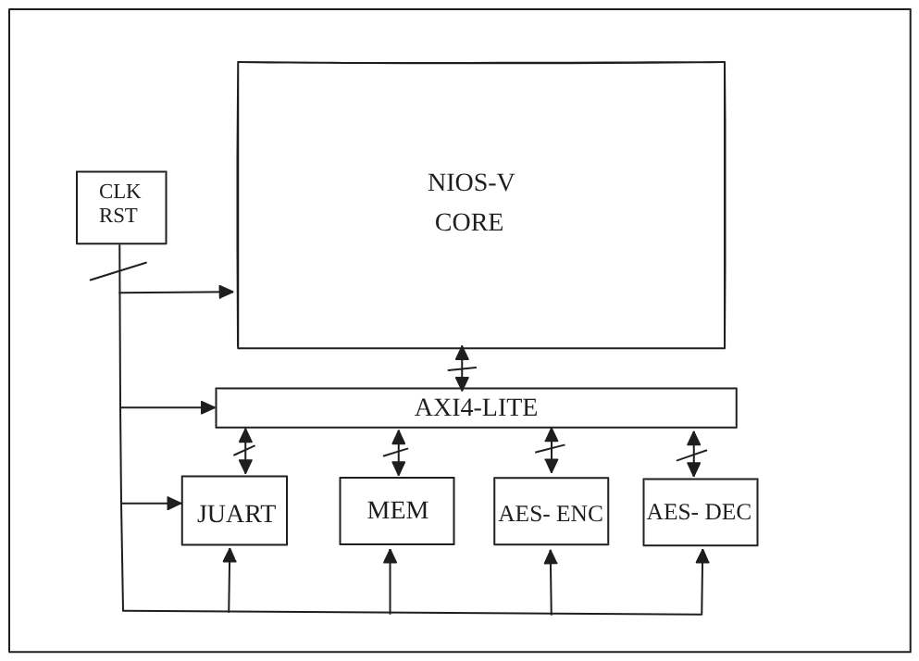
System Block Diagram
10

Slide 12
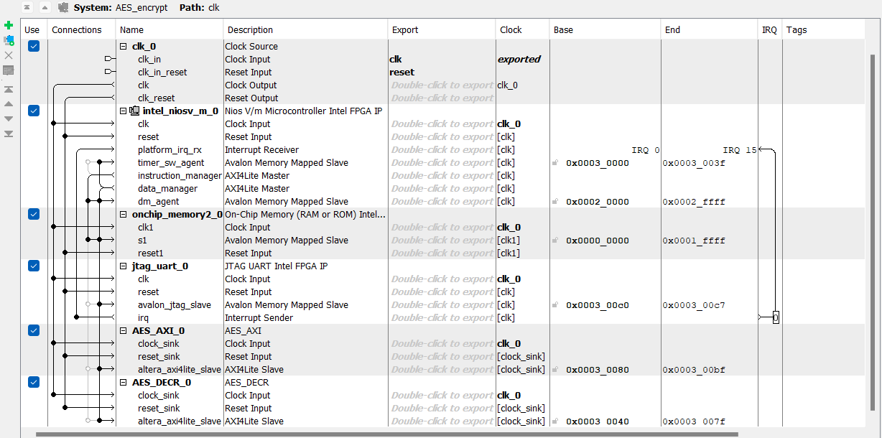
System Configuration in Quartus
11

Slide 13
Outputs Overview
12

Slide 14
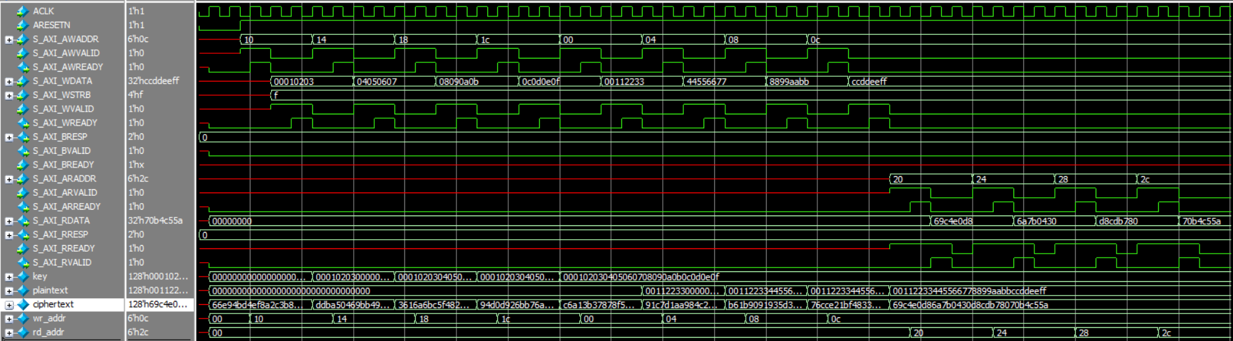
Simulation Results of AES Encrypt Wrapper
13

Slide 15
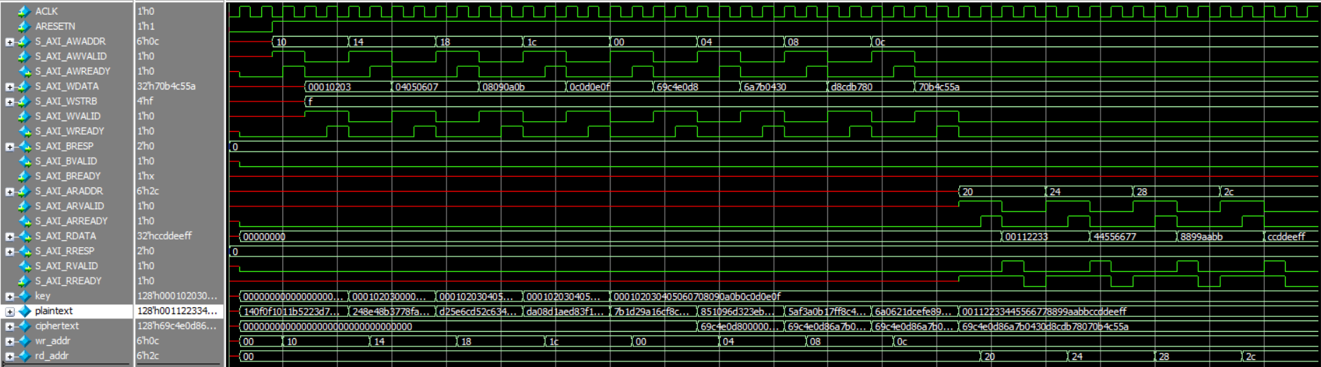
Simulation Results of AES Decrypt Wrapper
14

Slide 16
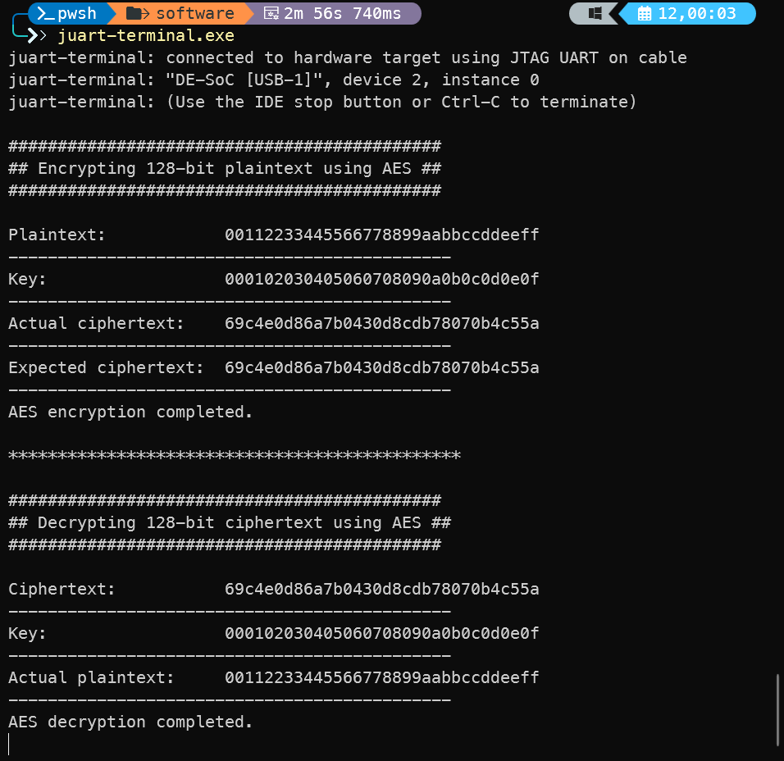
Juart Terminal Output
15

Slide 17
LIVE DEMO
16

